Slide 1
A Request Made 100 Years Ago:
The Five First Saturday Devotion
And
Our Lady’s Peace Plan From Heaven

Slide 2
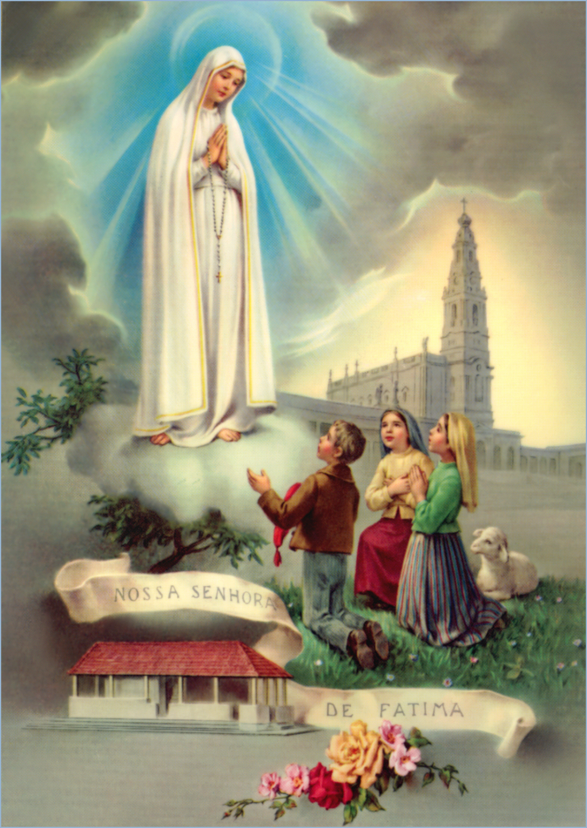

Slide 3
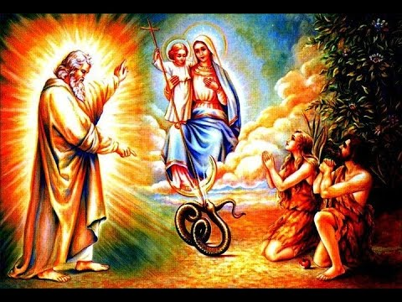
“I will put enmity between you and the woman, and between your offspring and hers…” (Gen.3:15).

Slide 4
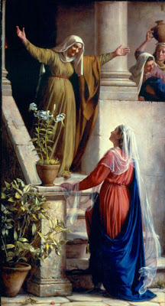
“All generations will call me blessed.”

Slide 5
“He who could create all things from nothing would not remake His ruined creation without Mary…Without God’s Son, nothing could exist; without Mary’s Son, nothing could be redeemed.” St. Anselm

Slide 6
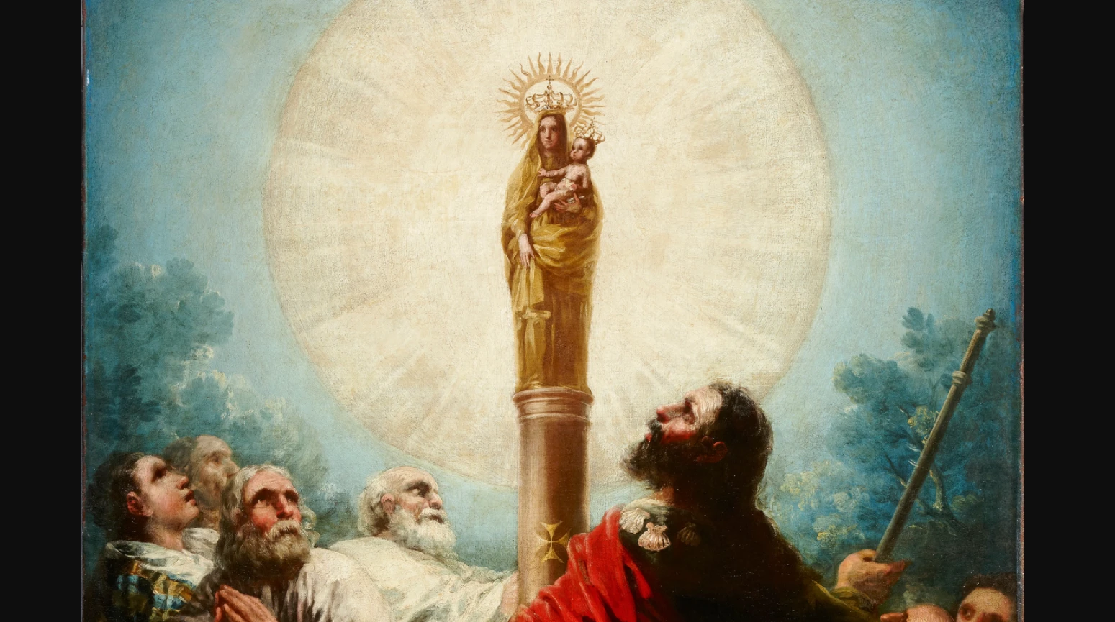
The First Marian Apparition:
Our Lady of the Pillar

Slide 7

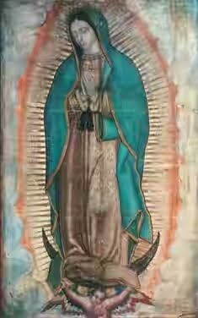
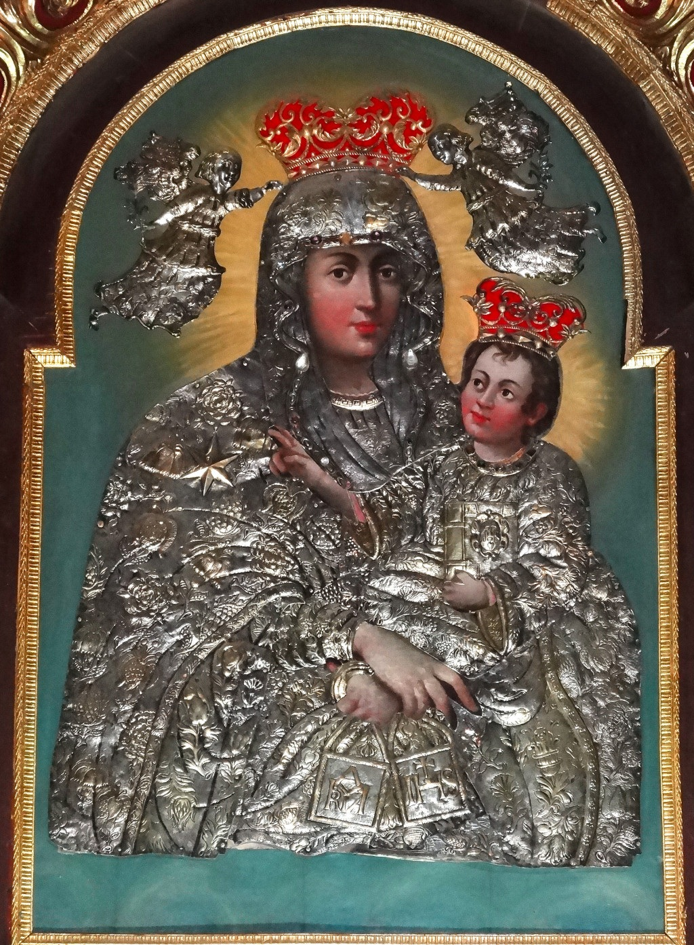
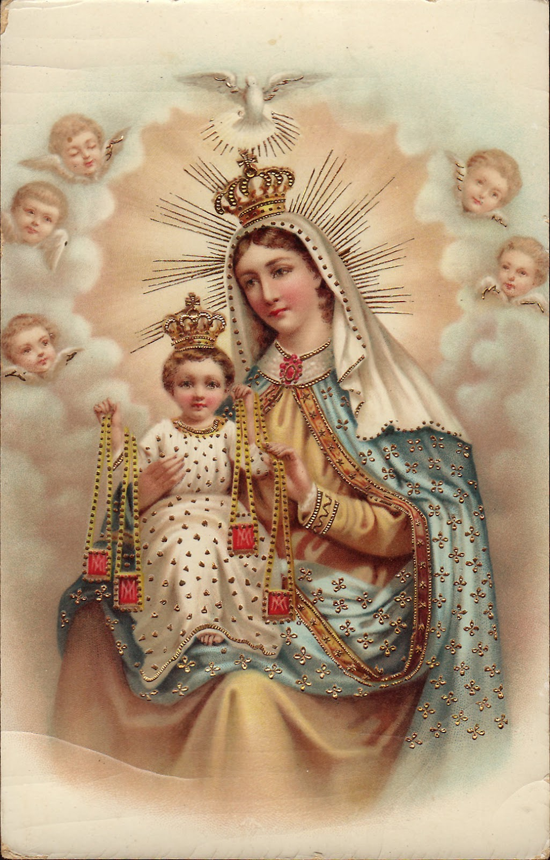
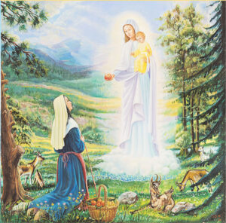
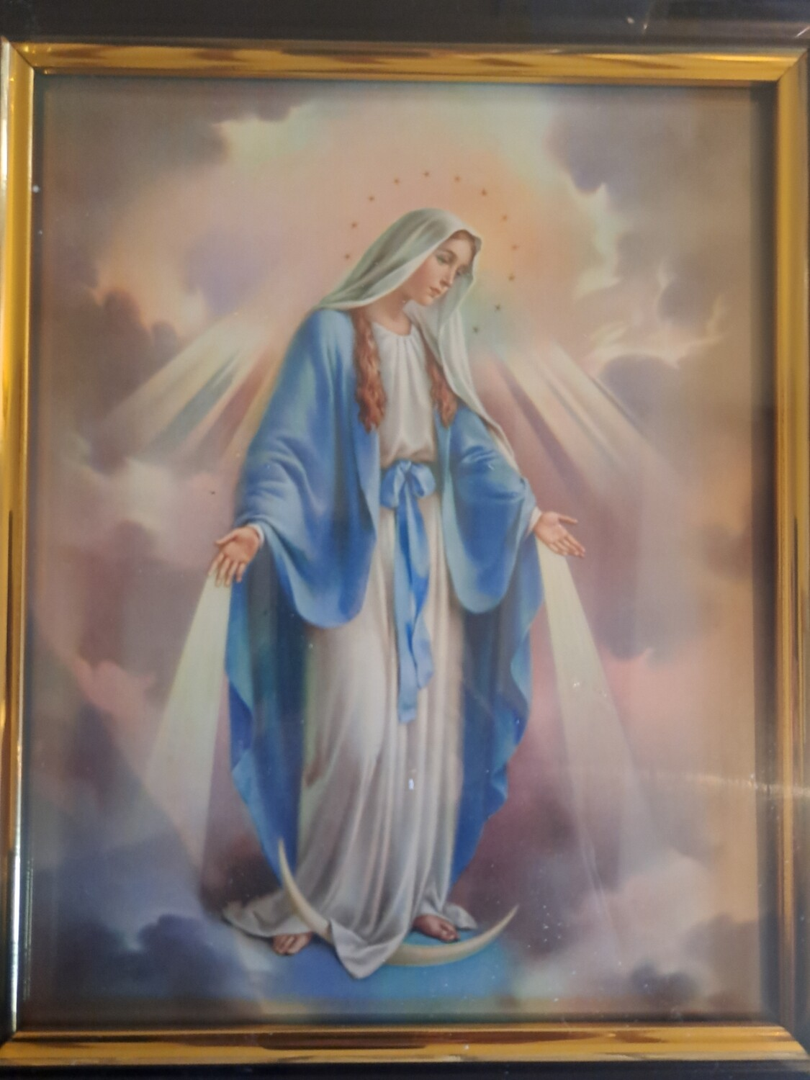
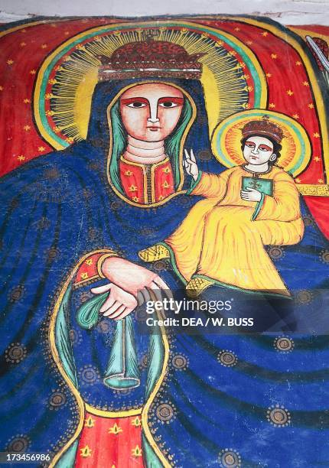
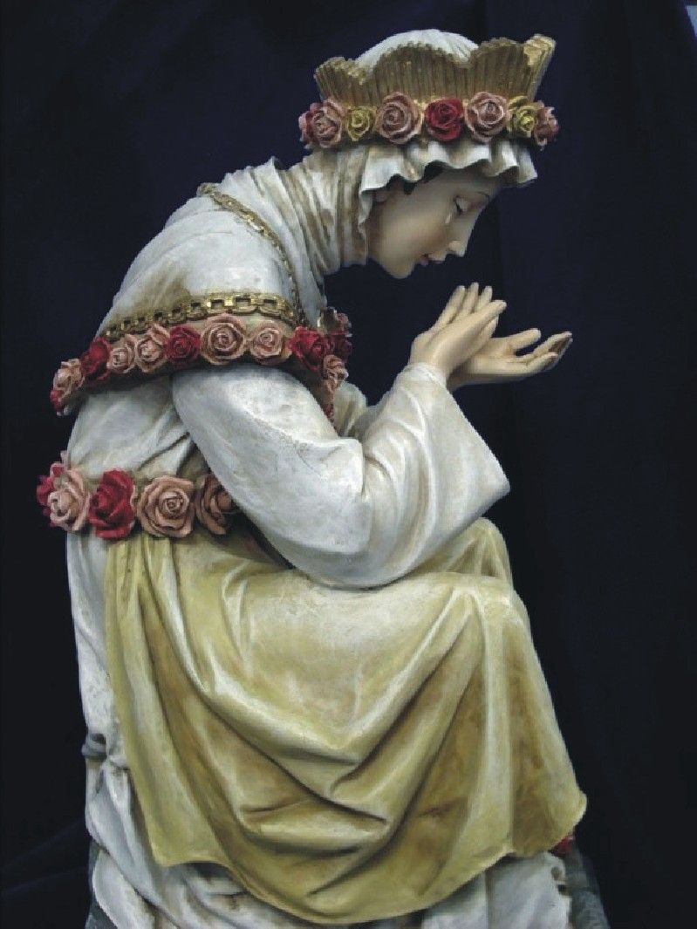
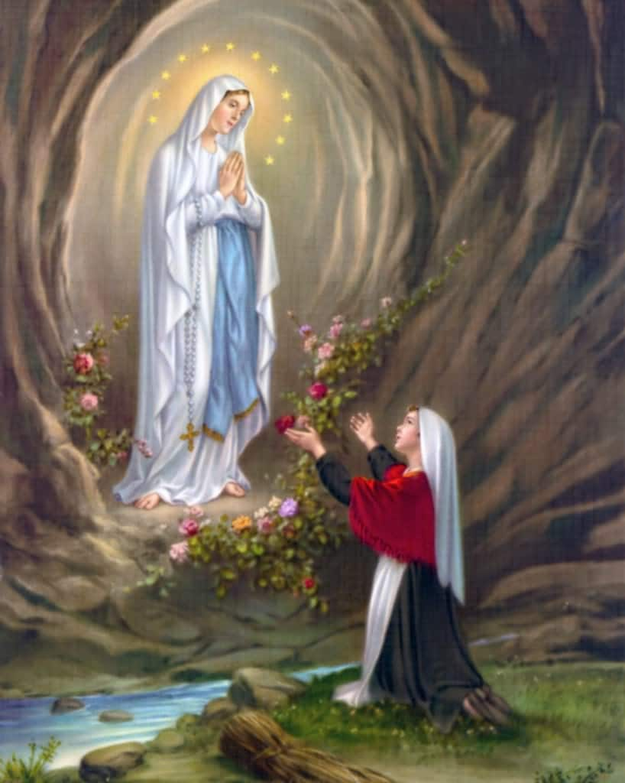
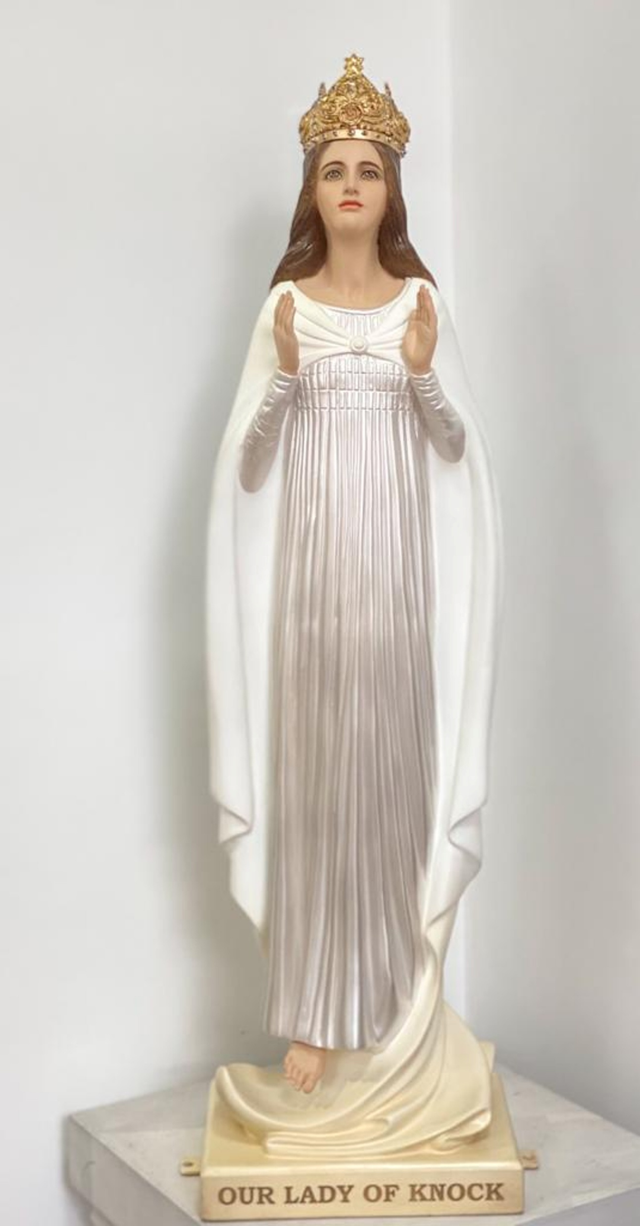
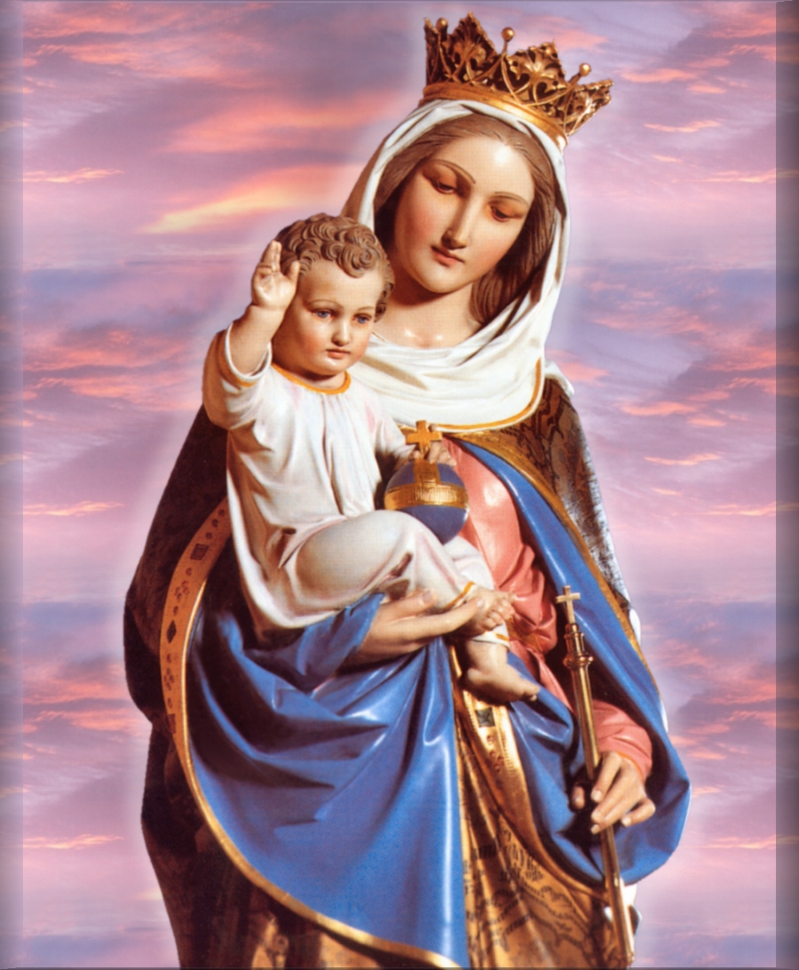
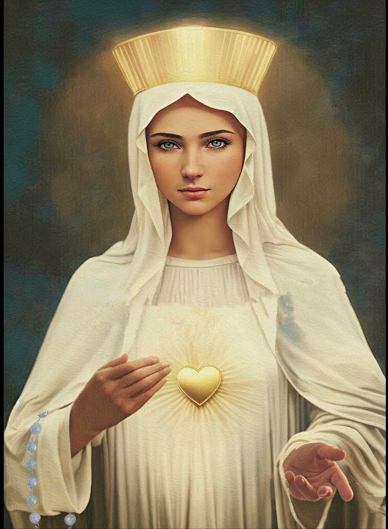
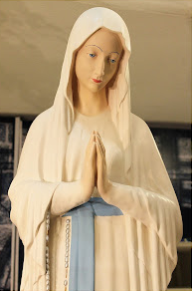
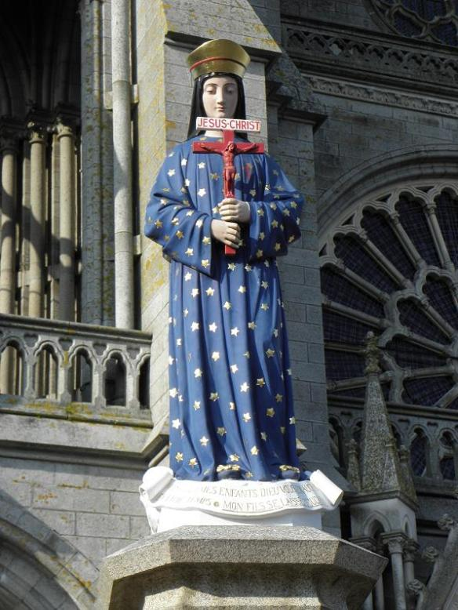
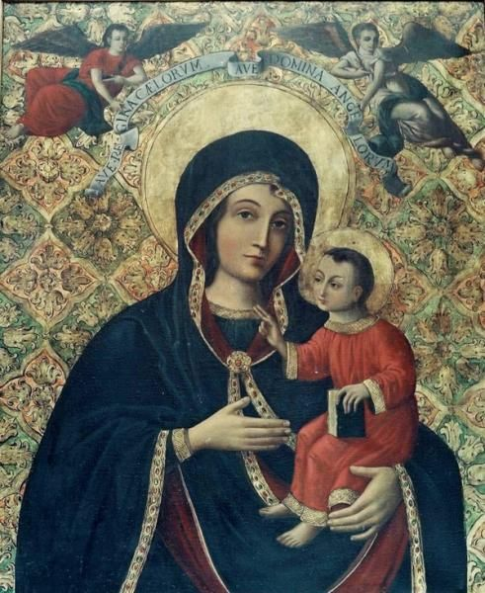
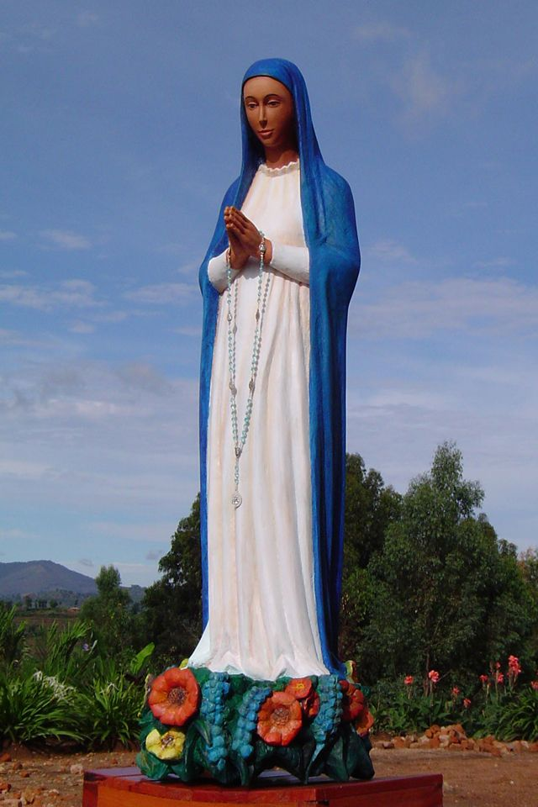
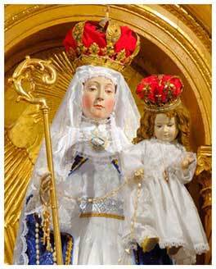
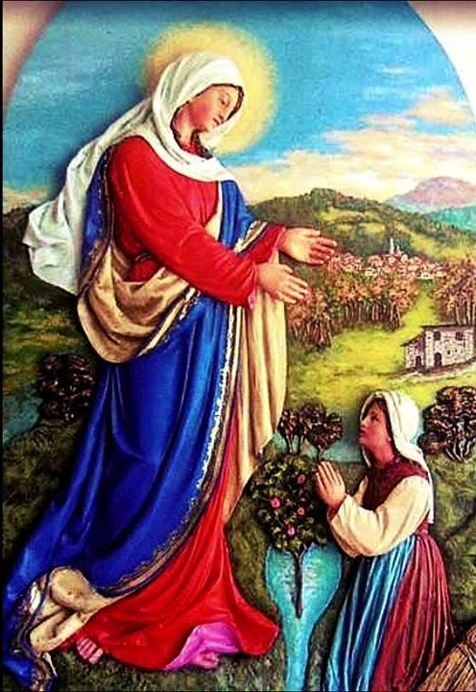
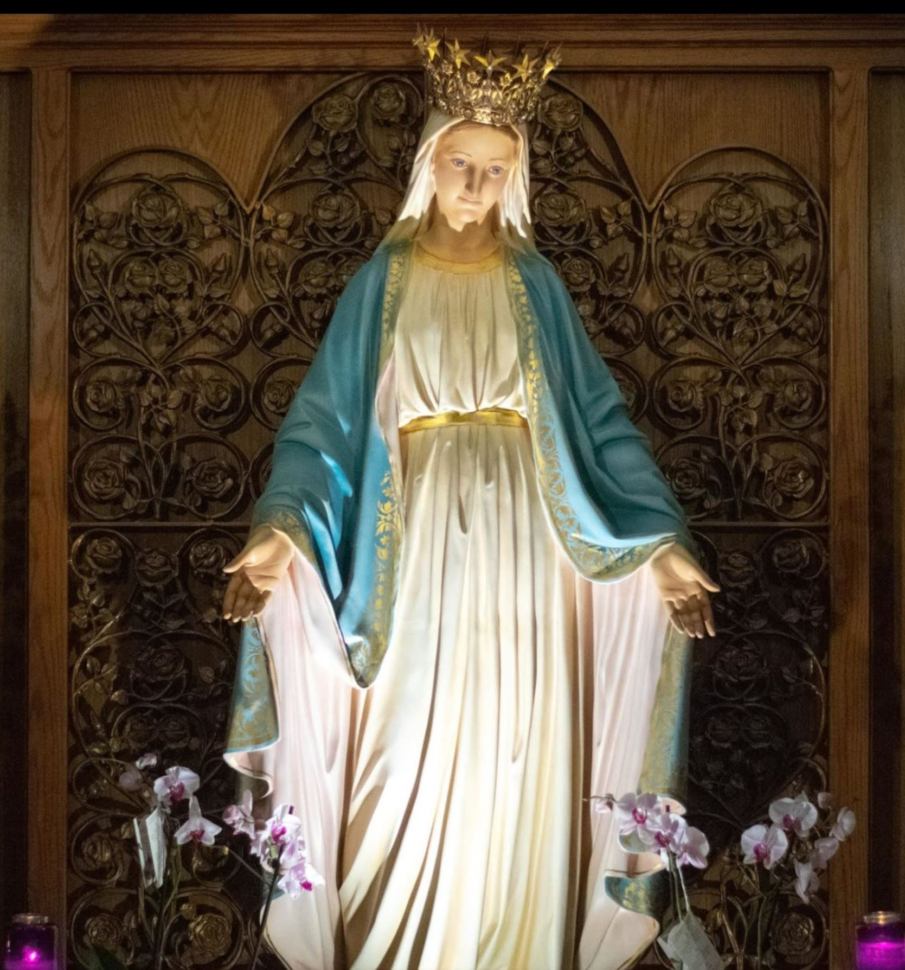
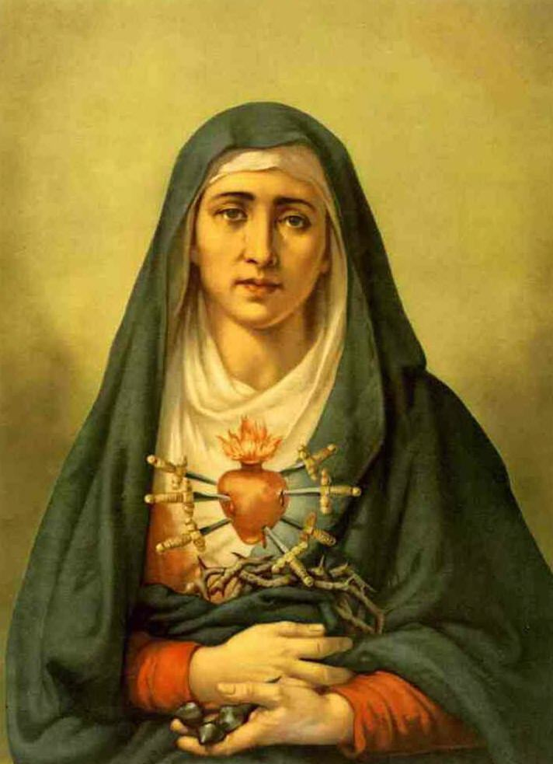
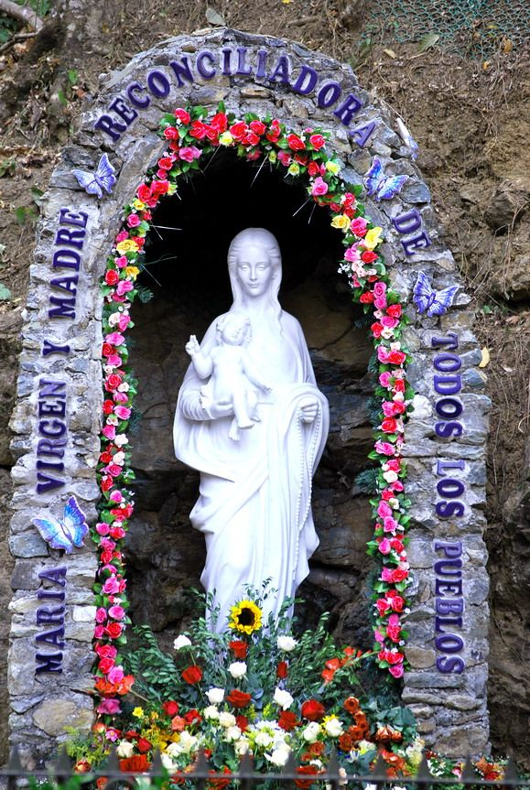
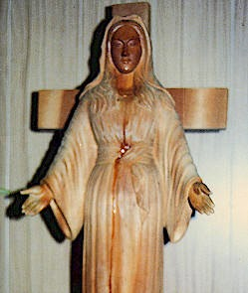
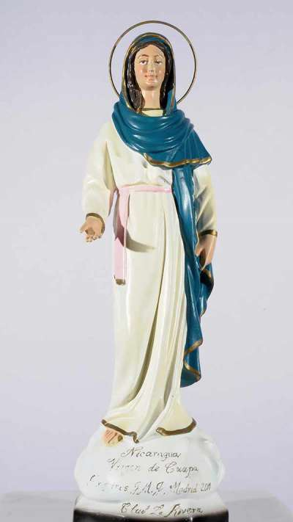
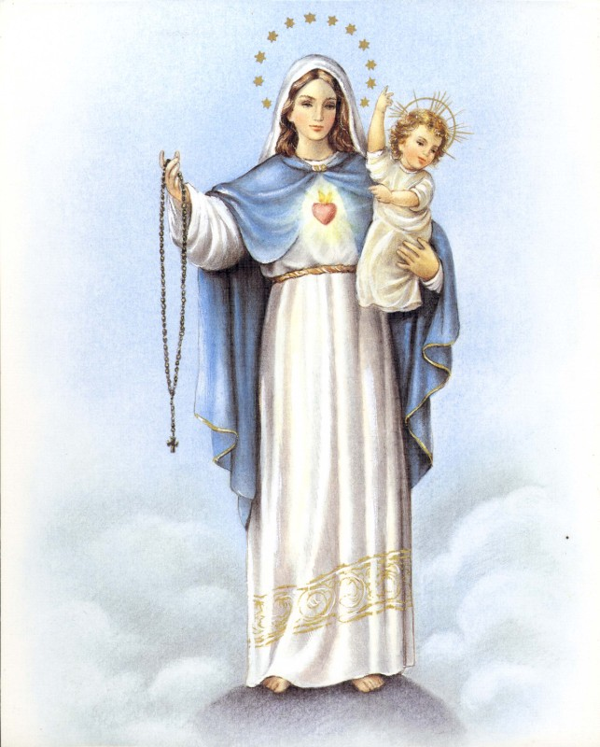
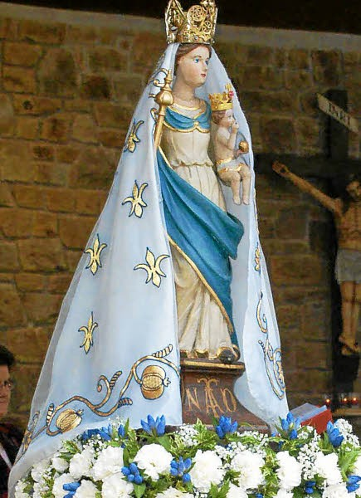

Slide 8
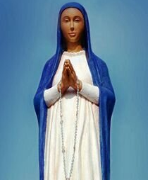
Whenever she appears to a certain place or to a certain person, she is speaking not only to them, but to the whole world, and that the revelations of the apparitions are to be applied to all the faithful.

Slide 9
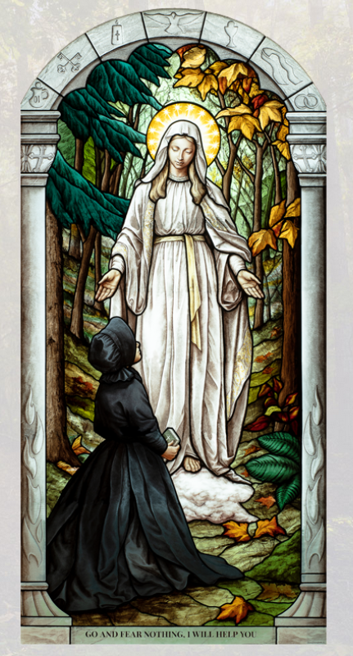
Our Lady of Champion

Slide 10
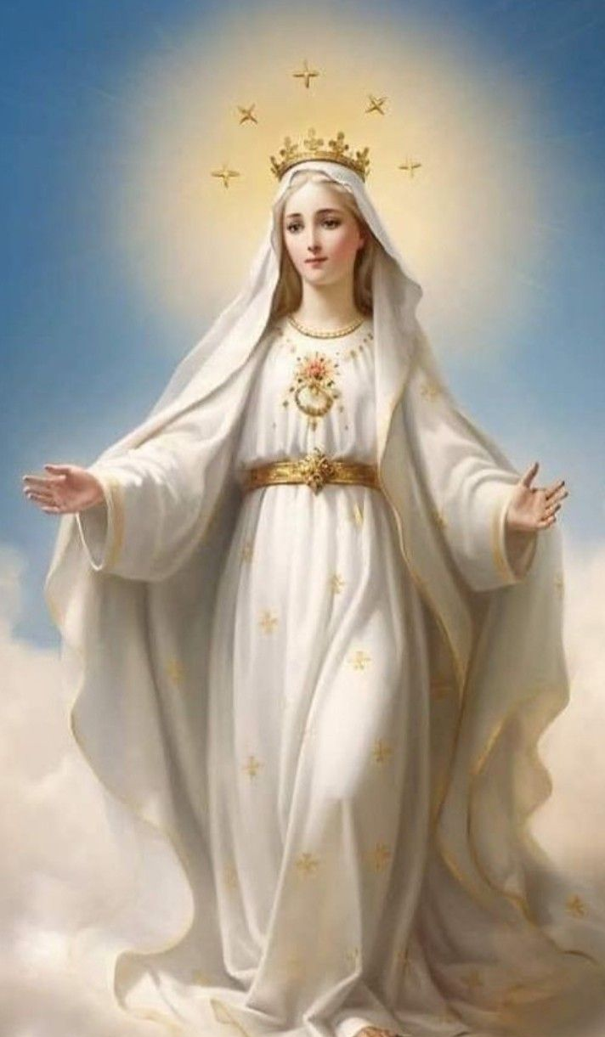
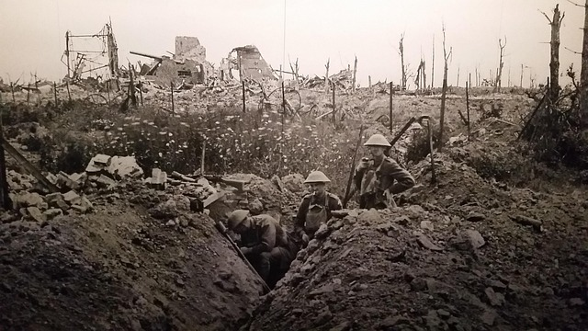

Slide 11
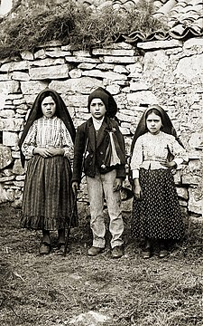
Lucia dos Santos
Francisco Marto
Jacinta Marto

Slide 12
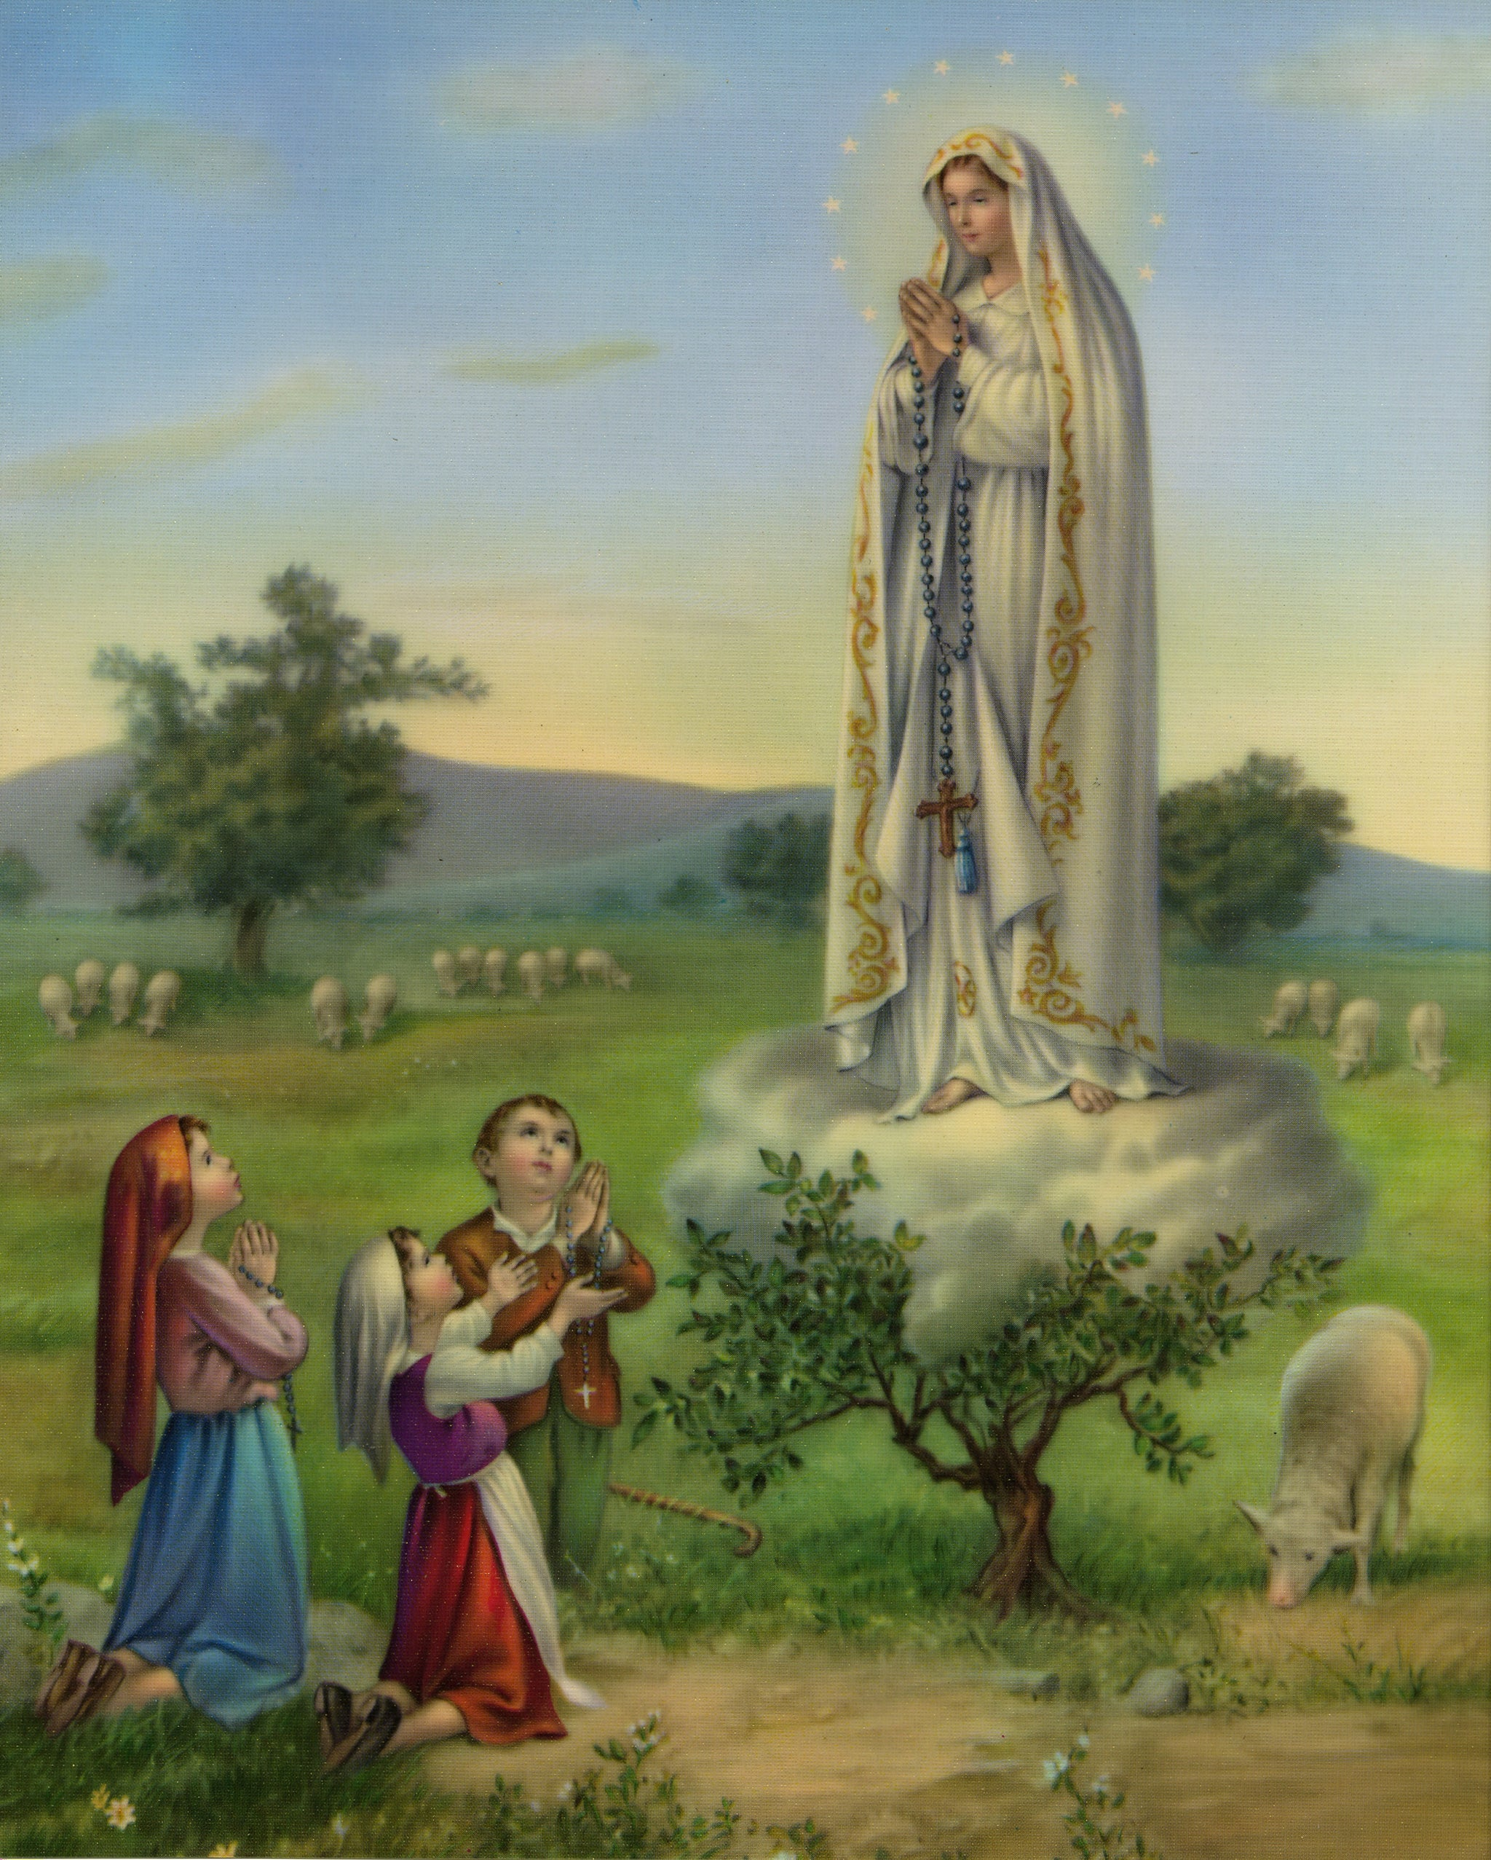
She appeared to be about 17 years old. “She was more brilliant than the sun, and radiated light.”

Slide 13
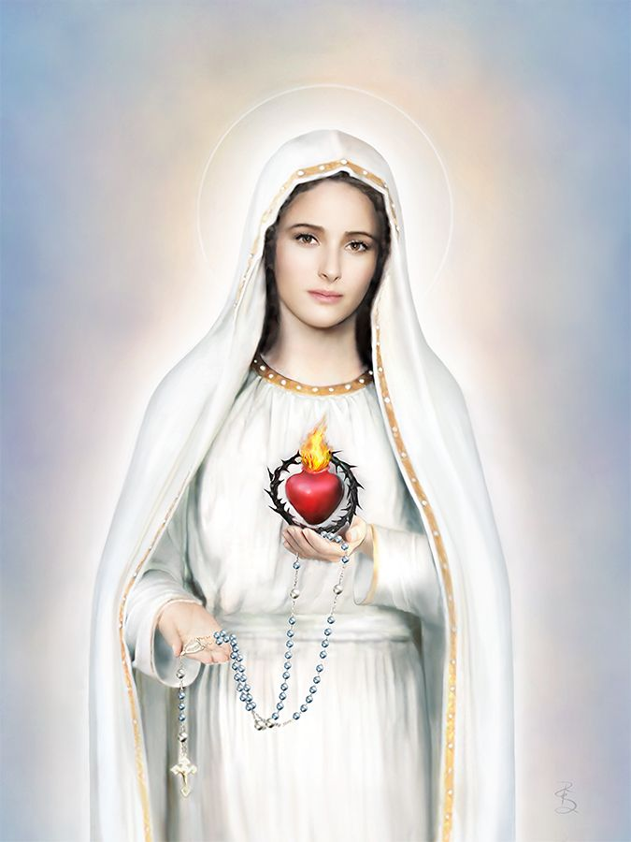
“Jesus wishes to make use of you to make me known and loved. He wants to establish in the world devotion to my Immaculate Heart.”

Slide 14
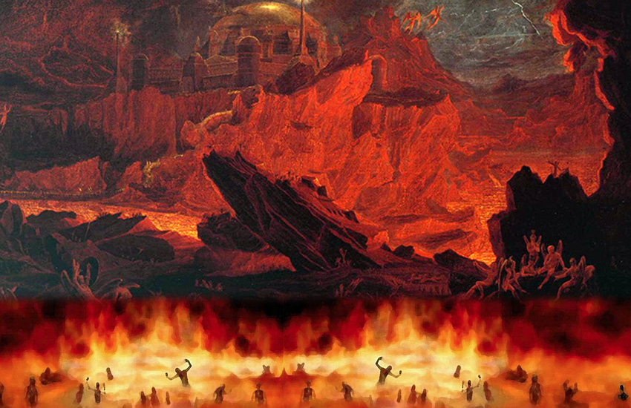
“If what I say to you is done, many souls will be saved and there will be peace. The war is going to end. But if people do not stop offending God, another and worse one will begin in the reign of Pius XI”

Slide 15
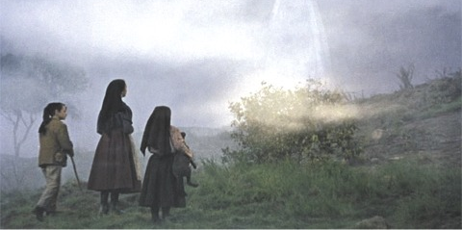
“Had they not taken you to Ourem, the miracle would have been greater”

Slide 16
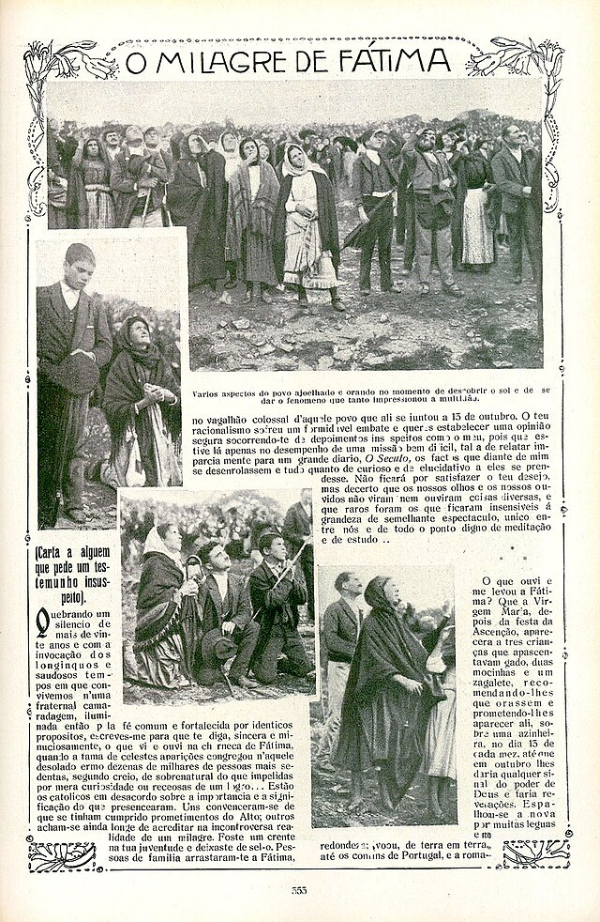
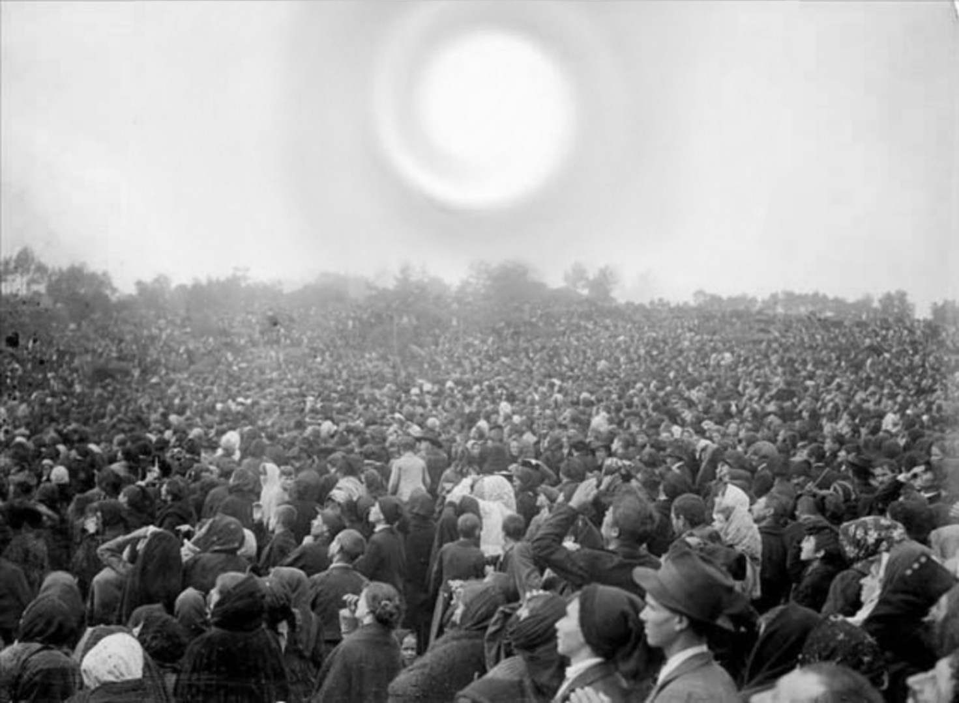
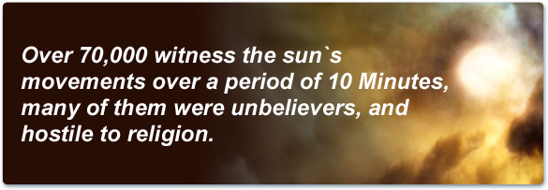
This Photo by Unknown Author is licensed under CC BY-SA

Slide 17
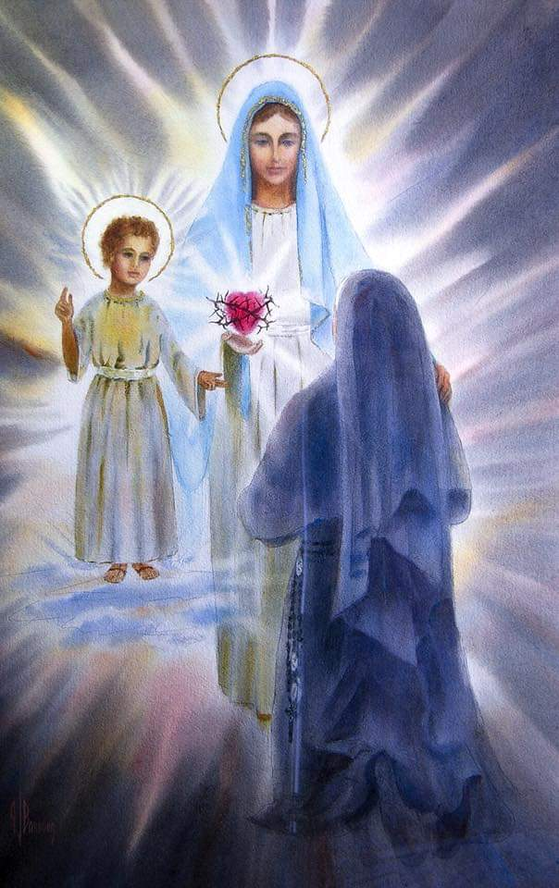
“Have compassion on the Heart of your Most Holy Mother, covered with thorns, with which ungrateful men pierce it at every moment and there is none to make an act of reparation to remove them.” The Child Jesus

Slide 18
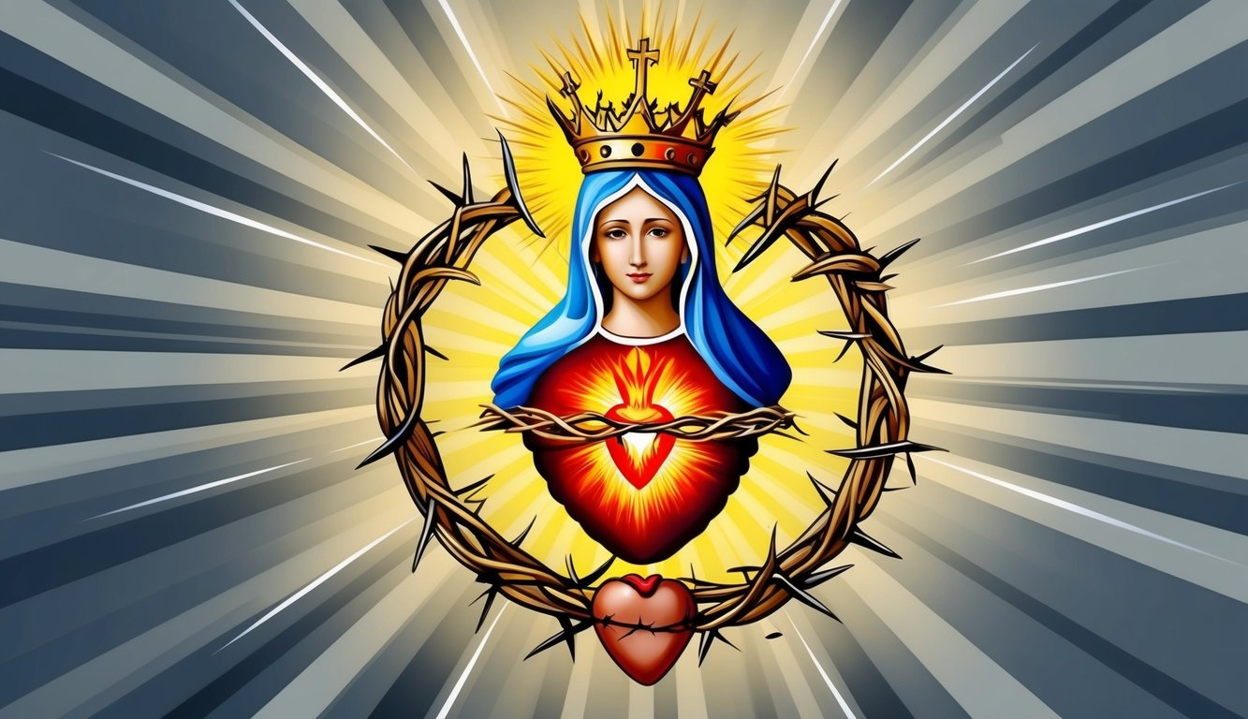
On the first Saturday of five consecutive months,
Shall confess,
Receive Holy Communion
Recite five decades of the rosary and
Keep me company for fifteen minutes while meditating on the fifteen mysteries of the rosary,
With the intention of making reparation to me.”
“Look, my daughter, at my Heart, surrounded with thorns with which ungrateful men pierce me at every moment by their blasphemies and ingratitude. You at least try to console me and announce in my name that I promise to assist, at the moment of death, with all the graces necessary for salvation, all those who:

Slide 19
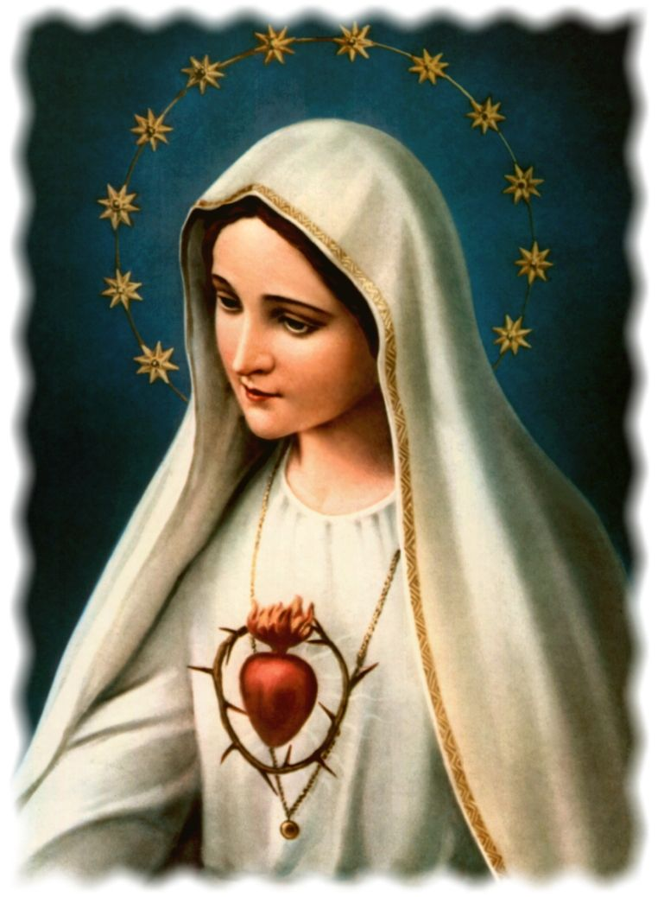
“God wants to use you to establish in the world the devotion to my Immaculate Heart.”
“ I want my whole Church to acknowledge that consecration as a triumph of the Immaculate Heart of Mary, in order to later extend its cult and to place devotion to this Immaculate Heart alongside devotion to my Sacred Heart.”
Jesus to Sr. Lucia
“To save them God wishes to establish in the world devotion to my Immaculate Heart.
“The Lord has confided the peace of the world to her.”
St. Jacinta

Slide 20
Blasphemy
“The use of insulting words in reference to God and His Church; it is insulting language which expresses contempt for God, either directly or through His saints and holy things.” The Baltimore Catechism
Five Blasphemies Against the Immaculate Heart of Mary
Blasphemies against Her Immaculate Conception
Blasphemies against Her Perpetual Virginity
Blasphemies against Her Divine Motherhood, in refusing at the same time to recognize her as the Mother of men.
Blasphemies of those who publicly seek to sow in the hearts of children indifference or scorn, or even hatred of this Immaculate Mother
Offenses of those who outrage Her directly in Her holy images.
CCC paragraph 2146 says, “The 2nd Commandment forbids the abuse of God’s name, i.e., every improper use of the names of God, Jesus Christ, and also of the Virgin Mary and all the saints.”
Paragraph 2148 adds that blasphemy “is directly opposed to the 2nd Commandment. It consists in uttering against God – inwardly or outwardly – words of hatred, reproach, or defiance; in speaking ill of God; in failing in respect toward Him in one’s speech; in misusing God’s name…The prohibition of blasphemy extends to language against Christ’s Church, the saints, and sacred things.”

Slide 21
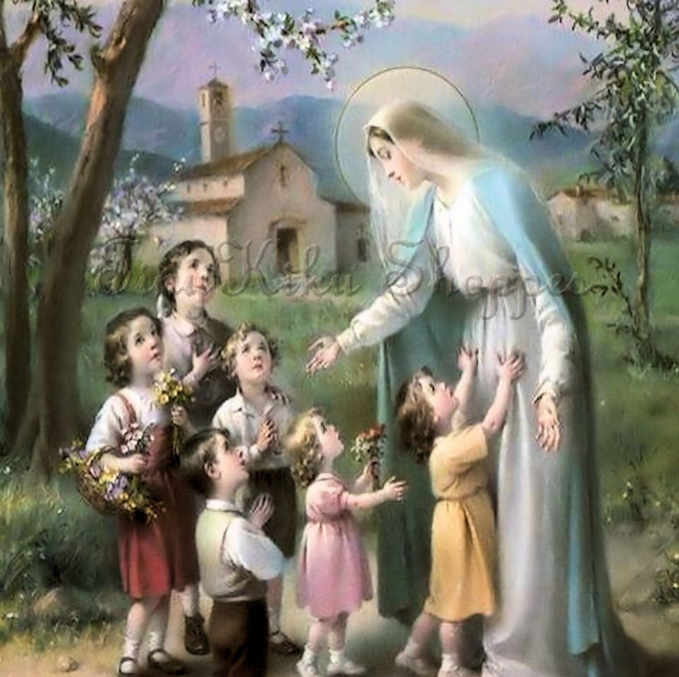
“There are so many souls whom the Justice of God condemns for sins committed against me, that I have come to ask reparation.”
The Blessed Mother
“Our Good Lord in His infinite Mercy asked me…to make reparation to the Immaculate Heart of Mary, and to implore pardon and mercy in favor of souls who blaspheme against Her, because the Divine Mercy does not pardon these souls without reparation.”
Sr.Lucia

Slide 22


“I call on everyone who loves Mary to start making the Five First Saturdays a regular part of their prayer life…I highly recommend it as a great spiritual practice! Get a monthly tune-up with Confession, Mass, Communion, and immersing yourself in the Mysteries of the Rosary, all offered in reparation for the many serious offenses committed against Our Lady.” Fr. Donald Calloway, MIC

Slide 23
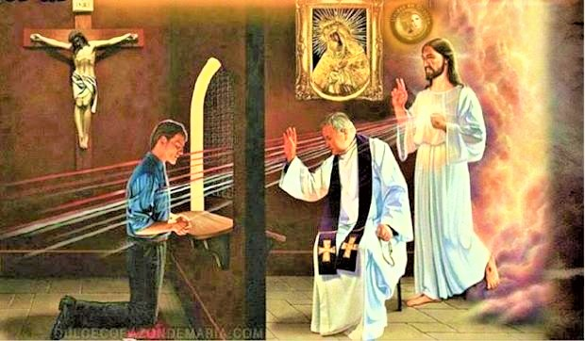
To Make a Worthy Confession
Examine your conscience
Be sorry for your sins
Firm purpose of amendment
Confess your sins to a priest
Do the penance the priest gives you
The Effects of Confession are:
Reconciliation with Godby which the penitent recovers grace
Reconciliation with the Church
Remission of the eternal punishment incurred by mortal sins
Peace and serenity of conscience, and spiritual consolation
An increase of spiritual strength for the Christian battle

Slide 24

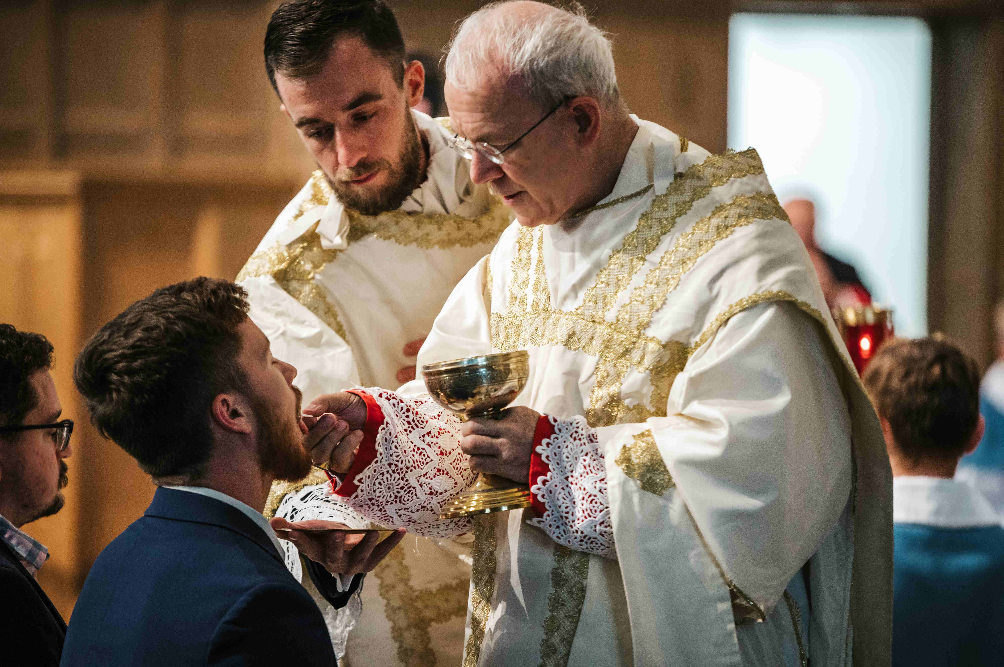
*Be in the state of grace – free from any unconfessed mortal sins
*Fast from food and drink for one hour
“We receive Our Lord as the tabernacle receives Him, whole and entire, and the angels adore Him in us even as they adore before the altar and before His eternal throne in Heaven. Our Lord desires to come into our souls more than we can desire to receive Him.”
Roman Catholic Daily Missal

Slide 25
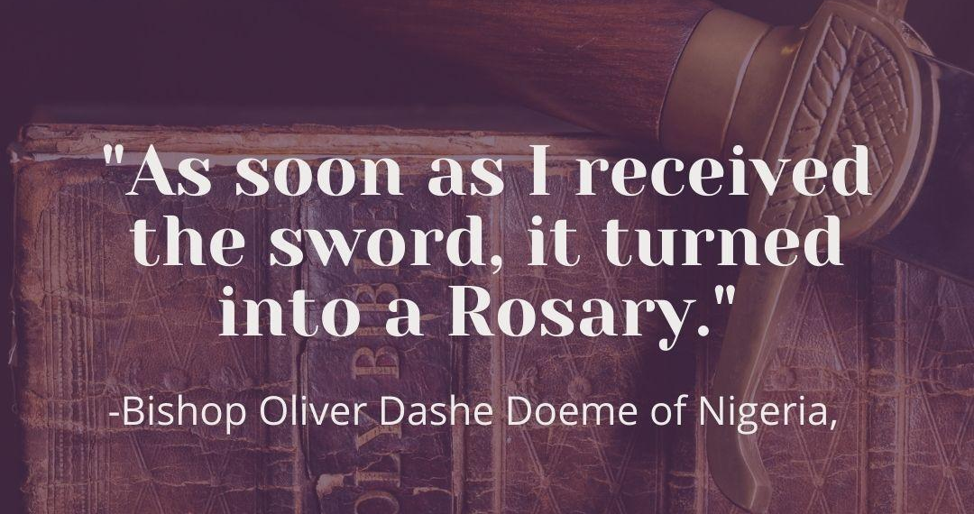

Slide 26
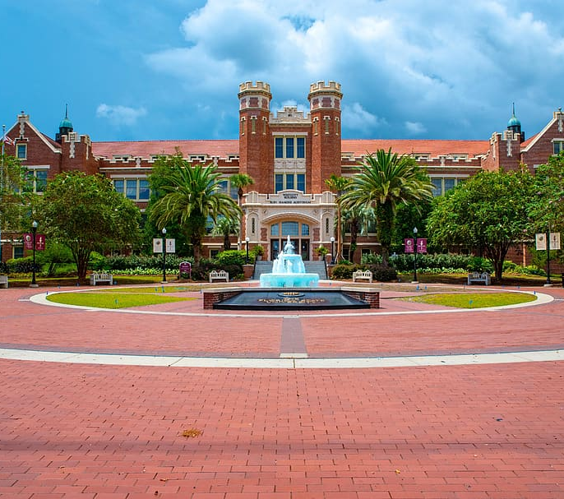
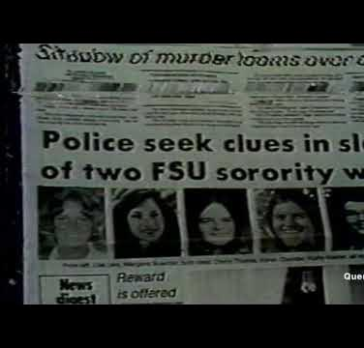

Slide 27
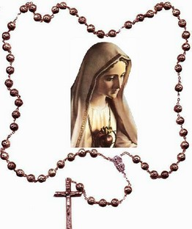
“Give me an army saying the Rosary and I will conquer the world.”
Pope Pius IX

Slide 28
15 Promises to Those Who Pray the Rosary
As given to St. Dominic and Bl. Alan de la Roche
To all those who shall recite my rosary devoutly, I promise my special protection and very great graces.
Those who shall persevere in the recitation of my rosary shall receive signal graces.
The rosary shall be a very powerful armor against hell; it will destroy vice, deliver from sin, and dispel heresy.
The rosary will make virtue and good works flourish, and will obtain for souls the most abundant divine mercies; it will draw the hearts of men from the love of the world to the love of God, and will lift them to the desire of eternal things. How many souls shall sanctify themselves by this means!
Those who trust themselves to me through the rosary shall not perish.
Those who shall recite my rosary devoutly, meditating on its mysteries, shall not be overwhelmed by misfortune. The sinner shall be converted; the just shall grow in grace and become worthy of eternal life.
Those truly devoted to my rosary shall not die without the Sacraments of the Church.
Those who faithfully recite my rosary shall find during their life and at the hour of their death the light of God, the fullness of His graces, and shall share in the merits of the blessed.
I shall deliver very promptly from purgatory the souls devoted to my rosary.
The true children of my rosary shall enjoy great glory in heaven.
What you ask through my rosary, you shall obtain.
Those who propagate my rosary will be aided by me in all their necessities.
I have obtained from my Son that all the members of the Rosary Confraternity shall have as their intercessors, in life and in death, the entire celestial court.
Those who recite my rosary faithfully are all my beloved children, the brothers and sisters of Jesus Christ.
Devotion to my rosary is a great sign of predestination.

Slide 29


Slide 30


“Our Lady promised to postpone the scourge of war, if this devotion is spread and practiced. We see her putting off this chastisement in the measure that efforts are being made to spread it…peace or war depends on the Five First Saturday devotion along with the consecration (of Russia).”
Sr. Lucia

Slide 31

The fate of the world is tied to the First Saturday devotion.
Lucia to St. Carlo in a dream while he was in Fatima

Slide 32

Renew the First Saturday devotions and pray the rosary every day.
“If people do not change…they will hasten the arrival of the Third World War.”
The Blessed Mother to Bernardo Martinez

Slide 33

“I promise to assist, at the moment of death, with all the graces necessary for salvation, all who, in order to make reparation to me, on the First Saturday of five successive months, go to Confession, receive Holy Communion, say five decades of the Rosary, and keep me company for a quarter of an hour, meditating on the mysteries of the Rosary.”

Slide 34

The Peace Plan from Heaven
Penance and reparation
The daily recitation of the Rosary
The Five First Saturdays
Personal Consecration to the Immaculate Heart of Mary

Slide 35

First Saturday Virtual Pilgrimage
bluearmy.com/first-saturday-pilgrimage

